Slide 1
Selenium + Java Training
Trainer – Nikunj Shah

Slide 2
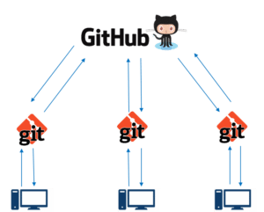
GitHub Introduction
To be very crisp about what exactly is GitHub, it is a file or code-sharing service to collaborate with different people.
GitHub is a highly used software that is typically used for version control. It is helpful when more than just one person is working on a project.
Say for example, a software developer team wants to build a website and everyone has to update their codes simultaneously while working on the project.
In this case, Github helps them to build a centralized repository where everyone can upload, edit, and manage the code files.

Slide 3
Why GitHub
GitHub provides you a beautiful visual interface which helps you to track or manage your version controlled projects locally.
Once you register on GitHub, you can connect with social network and build a strong profile.
Say more than two software developers are working on the same file and they want to update it simultaneously. Unfortunately, the person who save the file first will get precedence over the others.
In such cases Github document the changes and reflect them in an organized manner to avoid any chaos between any of the files uploaded.

Slide 4
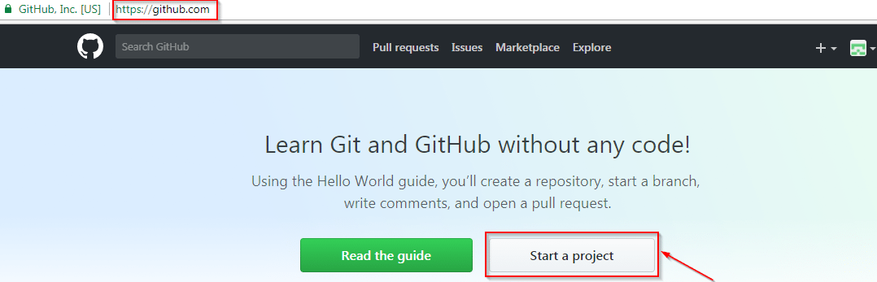
GitHub Account
Go to the link: https://github.com/ . Fill the sign up form and click on “Sign up for Github”.
Click on “Start a new project”.

Slide 5
Git Download for Windows
Go to the link: https://git-scm.com/download/win
Download and Install the package
Go to Command Prompt and check
Git –version
If the output comes then installation is successfull

Slide 6
Things we can do on Git
Create Repositories
Create various branches on Project
Merge the Changes
Version controlling
Cloning and Forking

Slide 7
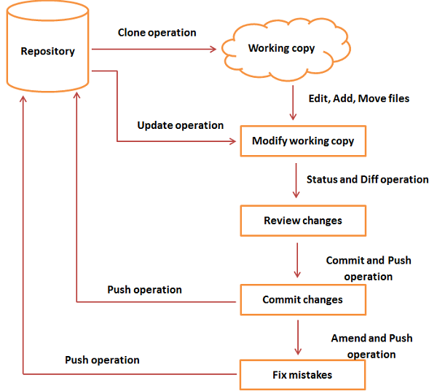
Git Life Cycle

Slide 8
How can work with Git?
GitHUB Directly
From Git Bash/ Cmd
From Eclipse Git Add-Ins

Slide 9
Demo Session

Slide 10
Upload Existing Project
git init
git status
git add .
git status
git commit -m “commit message“
Create Remote Repo in GitHub
git remote add origin [HTTPS ADDRESS]
git remote
git push origin master

Slide 11
Close Existing Project
git clone [HTTPS ADDRESS]
git status
git add .
git status
git commit -m “commit message“
git remote
git push origin master

Slide 12
Usefull Git Commands
git config
git init
git clone
git add
git commit
git diff
git reset
git status
git rm
git log
git show
git tag
git branch
git checkout
git merge
git remote
git push
git pull
git stash
https://dzone.com/articles/top-20-git-commands-with-examples

